Slide 1
Evading the Machine Learning Detector: A Virus’ Perspective
Group 10
Yuan Xiao, Xiaokuan Zhang

Slide 2

Problem Description
How should a virus disguise itself to fool the detector?
What are the important features of malicious executables?
Notes:
a bunch of anti-virus software, detecting malicious apps/binaries
No interested in detecting , but
However, to learn how to evade detection, first,

Slide 3
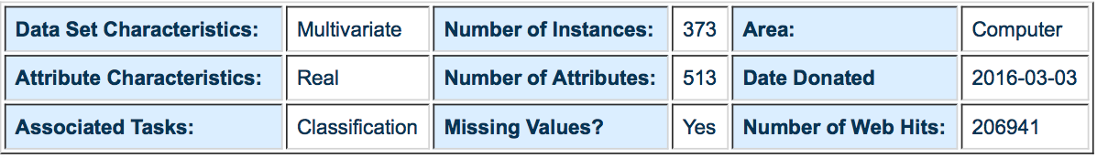
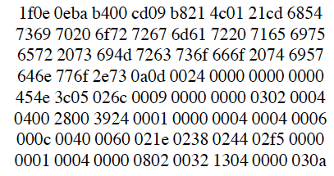
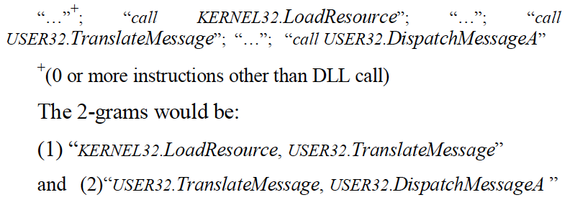
Malicious Executable Dataset
Dataset retrieved from UCI ML repository
500 hex features, 13 DLL features
Notes:
NO many dataset we can find.

Slide 4
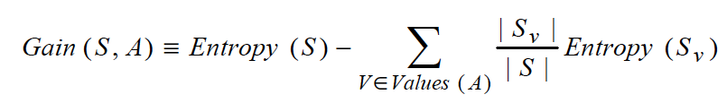
Related Work
N-gram Feature
a1b2c3d4 → 3-gram: a1b2c3 & b2c3d4
Binary/Assembly/DLL N-gram Feature Set
Hybrid model: Combine the three
Best 500 features for each set based on Gain
Algorithm: libSVM
Masud, Mohammad M., Latifur Khan, and Bhavani Thuraisingham. "A hybrid model to detect malicious executables." Communications, 2007. ICC'07. IEEE International Conference on. IEEE, 2007.

Slide 5
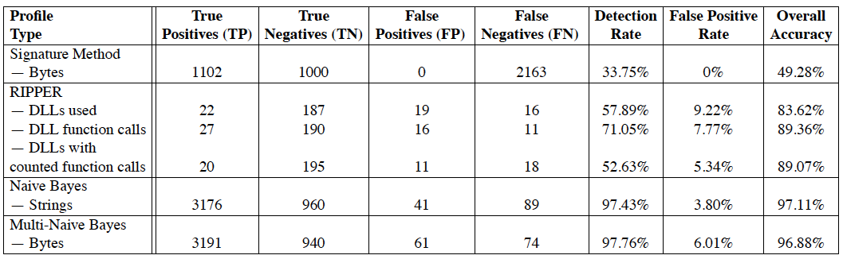
Related Work
Features: DLLs/GNU Strings/Byte Sequence(hex)
Algorithm: RIPPER/NB/Multi-NB
Best: Multi-NB (97.76%)
Schultz, Matthew G., et al. "Data mining methods for detection of new malicious executables." Security and Privacy, 2001. S&P 2001. Proceedings. 2001 IEEE Symposium on. IEEE, 2001.

Slide 6

Methods
Use WEKA + libSVM to train a model
Generate new virus data points and test

Slide 7
Originality
How should antivirus softwares detect a known/unknown type of virus?

Slide 8
Originality
How a virus can hide itself from the detection of antivirus softwares?
Notes:
The key idea of the project is to use machine learning as a tool to help us better understand how a virus can hide itself from the detection of antivirus softwares. Hiding malicious traces is a long-existing topic and new techniques keep emerging. However, there has never been a systematic way for the job. Thus we want to test from the database how a malicious can be disguised so that it is undetected by certain classifier models.
Best modification: with least modified attributes; adding better than removing

Slide 9
Challenge
No “names” file attached with the dataset – attribute meaning unknown Solution: contact author for help; otherwise can only do blind tests

Slide 10
Challenge
Low instance number (only 373 samples) Solution: the goal is not to exhaustively find the best model to classify malicious and non-malicious executables – the low sample amount is tolerable
Notes:
The dataset is about malicious executables (virus). Common features are extracted from real-world malicious and non-malicious executables. The dataset is very new (published in March 2016) but the weakness is that the sample number is relatively low compared to other datasets. However, the goal of our project is not to exhaustively find the best machine learning model to classify malicious and non-malicious executables. Thus we think the low sample amount is tolerable.

Slide 11
Challenge
Difficulty in generating new data instances Solution: without legal access to real-world virus samples, we can test by directly modifying attribute values in given malicious samples
Notes:
To do so, we can directly modify the extracted attributes rather than really implementing specific virus programs. This will also give us more global view of the topic.

Slide 12
Data Preprocessing
Instance example:
+1 1:1 3:1 5:1 7:1 9:1 11:1 26:1 30:1 33:1 37:1 39:1 42:1 44:1 50:1 53:1 57:1 59:1 67:1 79:1 82:1 84:1 92:1 98:1 102:1 107:1 111:1 113:1 126:1 128:1 132:1 140:1 154:1 157:1 164:1 168:1 171:1 186:1 189:1 193:1 213:1 219:1 227:1 231:1 238:1 258:1 268:1 275:1 279:1 282:1 291:1 302:1 318:1 331:1 339:1 362:1 367:1 369:1 378:1 388:1 400:1 409:1 412:1 417:1 419:1 427:1 431:1 446:1 449:1 455:1 457:1 466:1 476:1 491:1 497:1 500:1 503:1 -1
All attributes are binary
Attributes with FALSE value are not shown

Slide 13
Evaluation
Key: comparison with known hiding schemes
Modify attributes blindly
Look for best hiding modifications
Match with existing schemes
Analyze from existing schemes
Extract into attributes
Test with modified data
Notes:
Meanwhile, we will also compare the modifications we do to existing hiding schemes in security field. It can be done in two directions. Firstly, we blindly modify dataset and look for possible way to hide a malicious executable. Then we compare such way to existing schemes. Secondly, we try extracting from existing schemes possible ways to modify the dataset and verify if that can work for certain classifier models.

